Slide 1


Thoughts
User interface ideas

Slide 2
Design Considerations

Slide 3
What People think#
Users are not overly interested in how the page looks they just want to complete a task as quickly as possible.
Web usage is motivated by the desire to save time
Gimmicky / technical / marketing terminology and phrases confuse users
Imagery, colours and animation are tuned out if:
generic or not related to content
obviously fake
too polished,
cold, or technical
looks like it might be an ad.
They are not open to
promotions
marketing content
giving you more information they they think is necessary
Front load any content you do display with important info (very start of paragraph).
users will ignore everything after the point its no longer important to them..
The ‘Hot potato’ users will abandon a page
The instant they believe it’s not relevant.
As soon as they get confused or

Slide 4
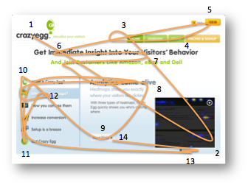
How people read pages

Slide 5
They wont even look at most of your page
even if you’re google (can can constantly tune and refine the design)

Slide 6
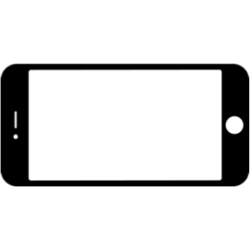
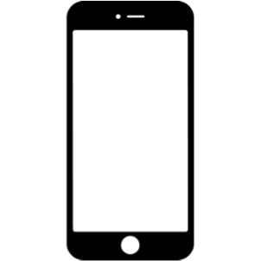
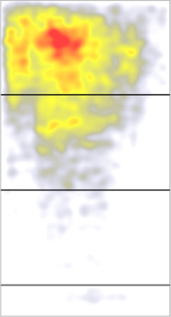
or more than one page height of content ?
Heat maps showing what happens when you take a mobile phone and turn it on it’s side so that its in landscape mode which allows the contents display over a wider area but to scroll vertically over a number of shorter regions.
** typically most users do not progress beyond two vertical height equivalents and abandon the page (which incidentally is approximately about the same amount of vertical space that they would be prepared to scroll when they are holding the phone vertically)

Slide 7
and don't Make People think#
Web design and layout is about giving users instant gratification with relevant information
Don’t add to users’ cognitive load
Heading Hierarchy MUST convey structure, relationship and relevance.
Don’t use elements in ways that work differently from the ‘expected’ norms.
Don’t alter a users mental model of how ‘everyday’ things work and function.
Web users typically work in a ‘Scattered Thinking’ mode
a state of constant partial attention in which they keep track of lots of partial things
but do not focus on any one of them

Slide 8
and let them just muddle through …
Faced with any sort of technology, very few people take the time to read instructions
Very few people, if any, will ever bother to read any of the help text available.
People try thing, back out, flit back and forth, just making up there own ‘stories’ for how thinks work and why?
People will type a site’s entire URL into Google search and then use the identical url when it come up in the list
when asked why, it becomes clear that they think Google is the Internet and this is how you use it…
It happens because it doesn’t matter to us whether we understand how things work,
as long as we can use them.
In the great scheme of things, it’s just not important to us.
Once we find something that works
no matter how badly - we tend not to look for a better way
We’ll use a better way if we stumble across one, but we seldom look for one

Slide 9
“Mobile first”

Slide 10
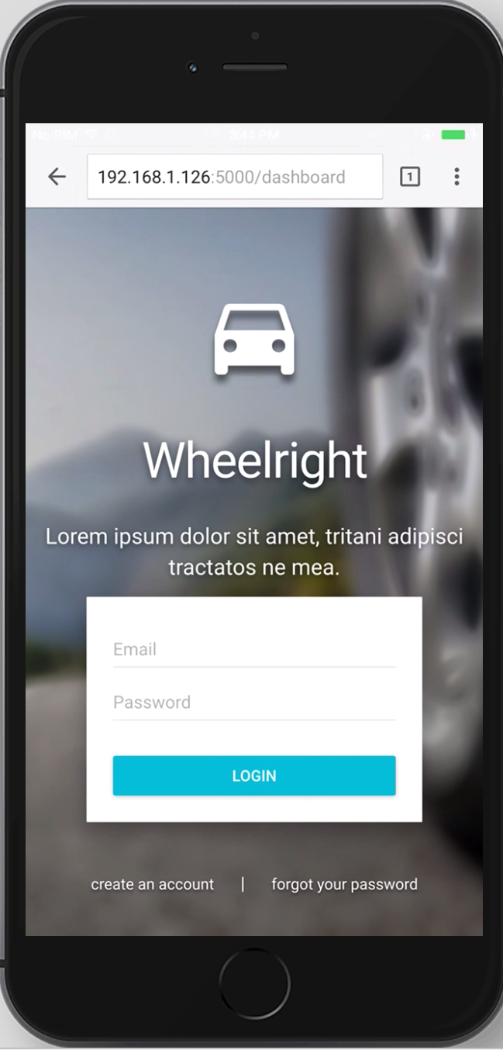
Why start with Mobile ?
A Hands-On Guide to Mobile-First Responsive Design
https://www.uxpin.com/studio/blog/a-hands-on-guide-to-mobile-first-design/

Slide 11
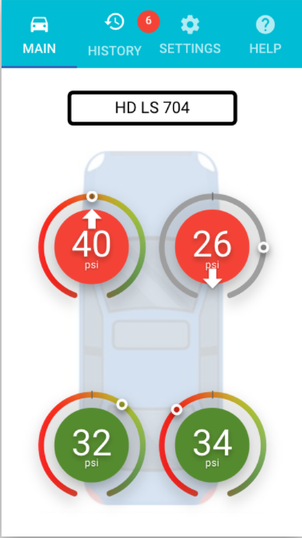
More than half of ALL your site accesses are going to using a mobile device
Accessing web sites via a mobile device is the MOST common way that that web pages are accessed - with 51.3% access in OCT 2016 and the trend is always (and it still is) been climbing steadily upwards.
http://www.telegraph.co.uk/technology/2016/11/01/mobile-web-usage-overtakes-desktop-for-first-time/
But building for Mobile First brings a number of aesthetic and functional design challenges which are mostly restricted by the SIGNIFICANT lack of space available even on a large MODERN device like a iPhone 6s Plus - shown to the right *
( * actual screen shot … )

Slide 12
Some info on Mobile web usage
Since mobile web access passed desktop way back in Nov 2016, the numbers of accesses has increased and is growing at about 5% per year and accelerating, in fact this is so globally important that google actually actively downgrades a sites “search ranking” if it does not offer a mobile friendly experience
https://www.hallaminternet.com/google-analytics-desktop-vs-mobile-vs-tablet-metrics/
Most internet usage these days is just shifting to mobile (figure do not include ‘App' connections to sites)
http://marketingland.com/digital-growth-now-coming-mobile-usage-comscore-171505
58% of all web visits are from Mobile
March 2017

Slide 13
Mobile users will spend less time on a site than their desktop counterparts, adopting a “Get In / Out and Move on” attitude. They don't want a ‘relationship’ they just want the information they need and then they quickly move on to the next thing. They are not prepared to Troll through complexity looking for it either.
This is backed up by the ‘Bounce’ rates for mobiles, which are higher that for desktop with more than 43% of all viewers leaving the site after just the first page. Mobile users, it seems, are not prepared to continue with a website that does not appeal to them or offer what they want / need on the very first page or that required them to progress to further pages beyond what they came to the site to look for.

Slide 14
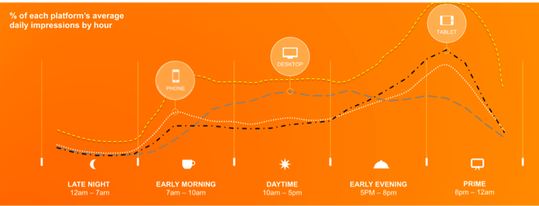
Where and when people are using it matters
Website access by device varies through the day. The image below shows how desktop is still important for daytime (for the at work audiences) where people are using the system provided to them by their employer, but outside of the office and when people are at homes then its the tablets and smartphones that dominate web access.
Typically phones are used to and from work, at weekends and whilst a person is ‘out and about’ during the day. After arriving home there is a significant switch over to using tablets and phones and a rise in online usage when people are out in the evening.
However, If you combine the usage of phones and tablet in a single “mobile device” figure then its cleat that “mobile” constantly outstrips all desktop web access at all points across the day, including business hours. in fact outside of business hours that difference can be as much as 300% higher than the usage by their desktop counterparts.

Slide 15
“Material Design”

Slide 16
Material Design
https://material.io/guidelines/material-design/introduction.html
Material Design is a design language that was developed in June 2014 by Google.
Material Design was built on a foundation of best practices in both traditional and web design, informed by user experience research and cognitive science. The design guidelines that developed from these findings are intended to be universally applied across all platforms and devices. Design conventions can affect the user's ability to understand the UI or complete certain tasks.
Material Design specifies in depth most aspects of how to build and how to design a web application and how it should act. This includes but is not limited to, screen layouts, components, colours, fonts, a unified typography (which fonts what sizes and colours are used for which items), what layers certain type so components must occupy, how things move, where things enter and leave, how pages work, mobile interfaces, swiping, touch events, mouse clicks, shadows, inputs, user notifications, usability, data formats, errors, help, feedback, images, navigation, permissions, scrolling, settings and a raft of other properties, metaphors, element sizing, features and functions…
There is a FULL online specification (which can be found at the URL at the top of this page) that covers all aspects of Material Design. It is laced with examples, videos and animations showing how it works, code samples, interactive designs, and each section as numerous examples of “Do’s and Don’ts”
Material design has been extensively tested, retested and user trialled over and over again, it’s principles are followed extensively. Its used on all android devices issued since 2015, countless mobile applications, and scores of web sites and written publications around the world.
Whether they know it or not billions of people every single hour of the day “just use” material design and its how they have come to expect a ‘good’ user experience to work.

Slide 17
“Usability and text”

Slide 18
Remove unnecessary words
Headings can be very important
but they should also be distinct kept as small as possible and used ONLY when absolutely necessary.
They should be as easy to read and clear as possible
and NEVER more than 7 to 8 words.
Remove all ‘happy’ or ‘fluffer’ text
no one actually cares about how great you are
and they certainly won’t want to read about it.
We’ve been scanning newspapers, magazines, and books all out lives,
our brains automatically expect a consistent typography hierarchy
out brains quickly ind the parts we’re interested in,
we know that it works
The rules for effective writing in newspapers / articles apply ever more so to the Web
where people will be expecting to spend less time.
We just don’t have the time to read any more than necessary.
Get rid of ALL filler words
Remove
distractions,
redundant links
redundant headings
buttons
adverts

Slide 19

De-emphasising ‘techno-babble’
allow the driver to concentrate on information (not the science / technology)
Proposal: When a tyre is within the “tolerance” specified by the driver, is there ANY need to show the units at all? And for the ultimate in simplicity any need to even show the measurement itself. “Your tyre is within limits, tick .. !! “
34
psi
34
psi
34
psi
34
psi
34
34
If units are needed then give the driver the option of switching them off, they know if its between 2.2 - 2.4 or between 30 - 34 even if most wont know (or/nor care) what the units mean, other than they are related to pressure…
2.4
bar
2.4
bar
2.4
bar
2.4
bar
2.4
2.4
✖︎ BAD
✔︎ GOOD

Slide 20

Don't show data - show significant information
Show what the driver needs to see when they need to act on whats important
For example the display of a whole range of depth figures does noting important and no additional information is gained by knowing 8.1 or 8.0 mm remain. In fact, it not really important to display anything much at all, just saying that everything is better than the limited specified, would also work …
10
mm
9
mm
8.1
mm
7.3
mm
6.7
5
3.9
At some configured point a “Warning” should be shown; Units may not be relevant after this point either, displaying the warning state may work, cars use the same paradigm “ONLY display a warning when there is a warning situation”
3.1
mm
2.9
mm
2.6
mm
2
mm
1.8
1.3
✔︎ GOOD
If units are shown (see previous slide) then give the driver the option of REMOVING them.

Slide 21
Honestly, measurement units are ‘irrelevant’ !
for almost every driver for almost entirely all of the time …

Slide 22
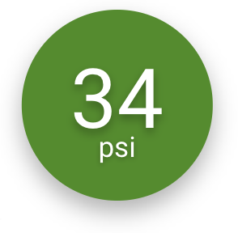



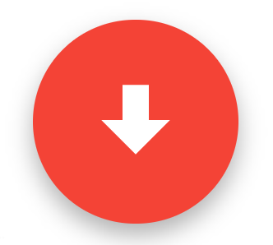






Use ‘indicators’ instead of text
34
psi
✖︎ BAD
✔︎ GOOD
Optionally a directional indicator can be used to emphasise (TOO MUCH) / (TOO LITTLE) conditions
potentially doing away with any form of NUMBER at all and when / if there is some indictor that there MAY be an issue and just showing simple iconic shape to indicate that something is not OK

Slide 23
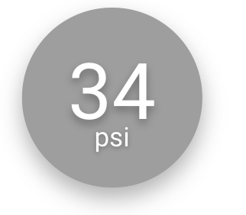
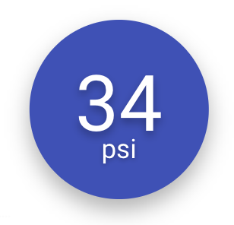
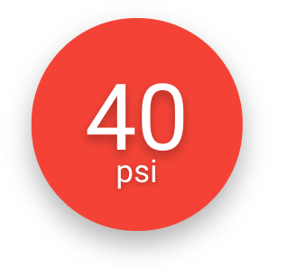
Reuse - rather than create new items **
Pressure reading taken, driver has not set any ‘trigger’ data for readings so no ‘OK’ or ‘Warning’ indications can be added on top of the reading, taken, so render in a neutral colour.
* There is a possible option were we could take an average of the pressures across all the tyres and if any one or more tyres are found to deviate by more than x% from the rest (and the driver has not registered any triggers) - show in an alternate neutral colour
driver has entered triggers and this are is within the acceptable limits of the trigger and so shows as a ‘OK’ with a a dark green colour
driver has entered triggers and this tyre is NOT within the acceptable limits of the trigger and so shows as a ‘Warning’ with a a red colour
** However using colour alone to distinguish between state is an EXCEEDING POOR design and un to 1/10 of the population wont be able to readily distinguish between those those states (see “colour blindness”)

Slide 24
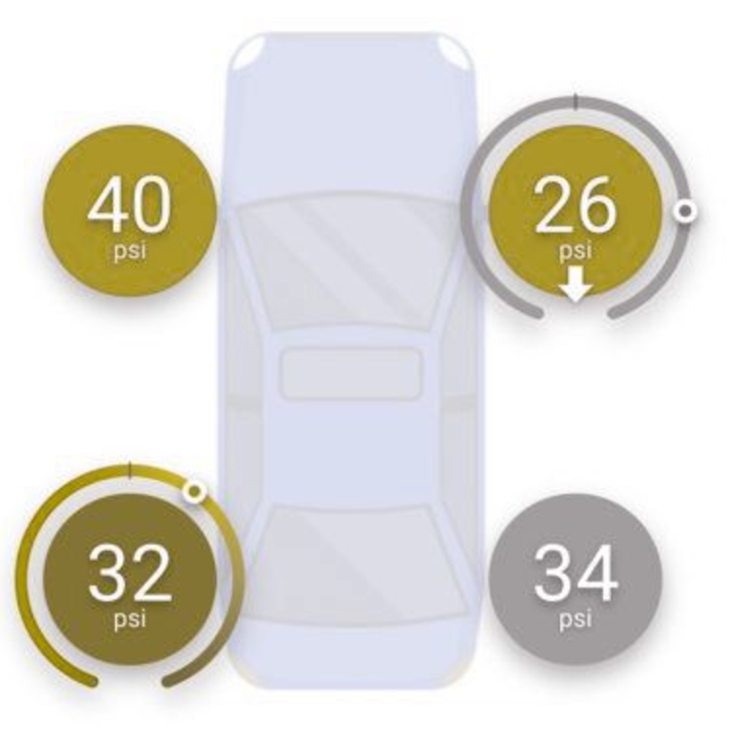
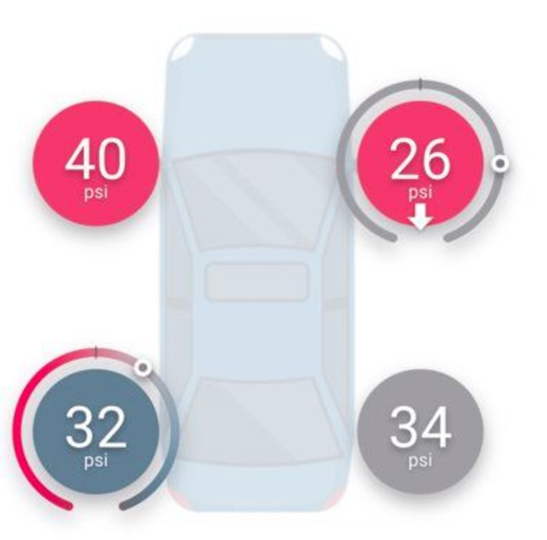
Colour Blindness
Deuteranomaly
Tritanope
There are seven main ‘types’ of colour vision deficiency or “Colour Blindness” and can effect about 1 in 10 of the male population of a country and about 1 in 1200 female.
Deuteranope - Green Deficient
Protanope - Red Deficient
Tritranope - Blue Deficient (rare in men, highest type found in women)
Deuteranomaly - Green Deficient (highest type found in men)
Protanomaly - Red Deficient
Tritanomaly - Blue Deficient (very rare < 0.0001% of the population)
Monochromacy - No Colour vision

Slide 25
Colour Blindness
✖︎ BAD
The addition of visual elements, other than just using a colour change, will allow visually / colour impaired people to quickly establish at a glance which of the values requires their attention and is a vital component of any good user experience and design
✔︎ GOOD

Slide 26
Application Simplification

Slide 27
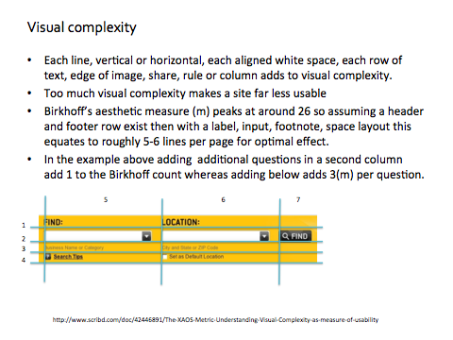

Slide 28
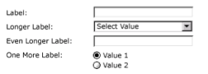
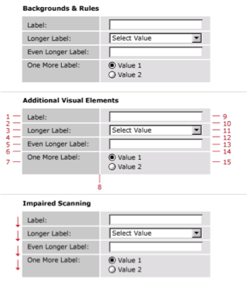
hard to read - don’t use shading to keep things together
✔︎ GOOD (not ideal)
Through gestalt (our innate rules of visual perception), if we shade the boxes above, an additional 24 visual elements are added to the layout: the white lines between each shaded box, each of the background boxes, and each visual horizontal line joining label to control (and above and below the contents - on the colour change).
These elements begin to distract our eye as it scans the various elements and makes it far more difficult to focus on the most important elements in the layout.
this pushes the result above the Birkhoff’s 26(m) ideal and it makes it harder to deal with the elements on this layout (in reality there are also other things on the page - which push the count way above the ideal value)
It would be better to put the labels above the inputs as this makes the count 10 instead of the 19 it has now, making it easier and quicker to fill in.
✖︎ BAD

Slide 29


Saving space on the page
settings
2
Last Drive Over
My Alerts
My Vehicles
My Preferences
My Details
…
About
Use a ‘Hamburger’ to replace the top Application Bar or Tabs allowing for a side menu to be slide out from that side, which will hold further actions or options
Friday 18 Aug 2017
L5 MNE
Drawers and Panels can keep things that are not immediately important off the screen until they are actually needed

Slide 30
Aside* { An application / benefit }
There is an interesting side effect of allowing a user to specify IN THE APPLICATION (rather than by system configuration) what units they want to see current / historic pressure readings in.
Say for example a Driver is on vacation or business in another country and they do a drive over and get a warning notice that something is wrong with a tyre pressure (most likely its going to be an under pressure alert).
So they pull over to the on site air pump with the intention of adding a bit of air - however the pump in the country they are in uses DIFFERENT units of pressure or a digital meter that has no way of switching (most pumps in the UK specifically).
No Problem, just switch the app over to using the ‘local’ units and now your readings are shown in the same reading as the air pump will use, so you can inflate the low tyre, safely to the same as the one on the other side (as shown in the app) and it will then be in the ‘OK’ pressure range, this can be done without worrying about doing some sort of metal gymnastics to do the conversion yourself. (especially hard if you don't know the conversion factor)
“Wheelright makes it easy …”

Slide 31
Some Alternate App Designs

Slide 32
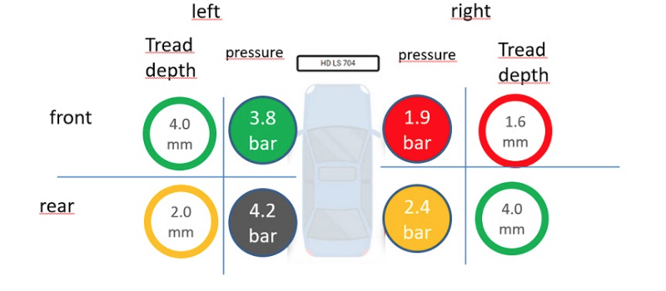
one suggestion for a possible layout from esso
✖︎ BAD

Slide 33
it works better on a table, but still not great
✖︎ BAD

Slide 34
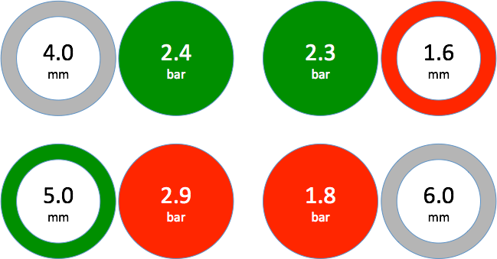
‘Left’ is on ‘Left’
‘Right’ is on ‘Right’
‘Front’ is logically at the front
lines just ‘redo' that there are 4 items
‘Rear’ is logically at the back
‘Car’ graphic takes up some space
Possible to also remove technobabble / engineering units

Slide 35
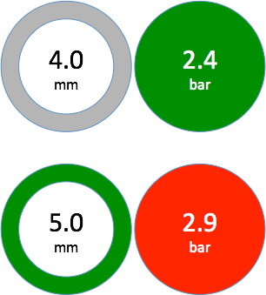
Reduce With using “Over & Under” Techniques
Layout could be be designed with FlexBox layout so the the display is altered so that the two sides of the vehicle would be ordered to fall above and below each other on a narrow mobile screen bu sit side by side on a wider table screen
The user would have to swipe down the screen on the mobile to see the other information present
Note the first portion of content should NOT occupy the whole of the screen otherwise there will be no visual clues for the user that there are more contents to come “below the fold”.
Also as was previously mentioned the user is NOT really inclined to scroll down much further anyway.
Friday 18 Aug 2017
Left Hand Side
4
2.4
90%
5
2.9
Right Hand Side
10%
✖︎ BAD
✔︎ GOOD

Slide 36
Last Drive Over
4
2.4
2.3
1.6
5
2.9
1.8
6
Friday 18 Aug 2017

Slide 37
Combining all ‘warnings’ into a single page view
Could just indicate whether the tyre is considered to be within the tolerances specified by a driver or outside.
If they are outside then display the appropriate symbol on the tyre and in the appropriate colour. If there is more than one ‘Warning” on the tyre display the worst warning type (tread depth ???)
If they look like buttons the driver will want to click on them, and in this way it will be possible to get more information about what that means, for each of the tyres independently …
However tends to be bad as you have MULTIPLE ‘OK’ or ‘Warning’ statuses competing for your brains attention …
Friday 18 Aug 2017
Last Drive Over
4
2.4
5
2.9
L5 MNE
✖︎ BAD

Slide 38
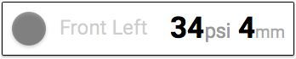
display the readings (date !!) in a single list, from top to bottom
Last Drive Over
however it should be noted that Engineering / Technical information such as units of measurement are mostly unless to most drivers
Brakes the Birkoff rules for visual data presentation
Friday 18 Aug 2017
✖︎ BAD

Slide 39
Combining everything into a single status
Last Drive Over
everything is within the limits that the driver set
Friday 18 Aug 2017
L5 MNE
✔︎ GOOD

Slide 40
Last Drive Over
Friday 18 Aug 2017
L5 MNE
✔︎ GOOD

Slide 41
one or more worn tyre(s) exist - possible options - in order to see alerts just click on the icon
Last Drive Over
Last Drive Over
2
2
or
Friday 18 Aug 2017
Friday 18 Aug 2017
L5 MNE
L5 MNE
✔︎ GOOD
✔︎ GOOD

Slide 42
Impart useful information with a human voice
Rather than presenting ‘cold’ technical facts to the user - offer them “user friendly” advice and humanise the application
Give the application a personality a sort of “Co-pilot” that is helpful and friendly that washes out for you and help you stay safe / performant
This gives the application a personality and play on the fact that humans imply obligations when a “personality” offers them something, that benefits them either directly or indirectly.
They are as a result more likely to continue to use the application as a result…
Tyre Alerts
The Rear Left tread is below the limit you set and should be checked
Front Right air is a little low. this is effecting performance and you are using more fuel
Friday 18 Aug 2017
L5 MNE
✔︎ GOOD

Slide 43

40

Slide 44
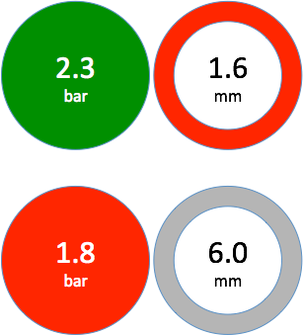
Left Hand Side
Right Hand Side

